Slide 1

CDISC Guidelines for Annotating CRFs
CDISC Focus Group

Slide 2
Outline
The FDA requirements
CDISC Guidelines
Overview and general rules Specific rules with examples
Appearance & format

Slide 3

The FDA reviewer

Slide 4
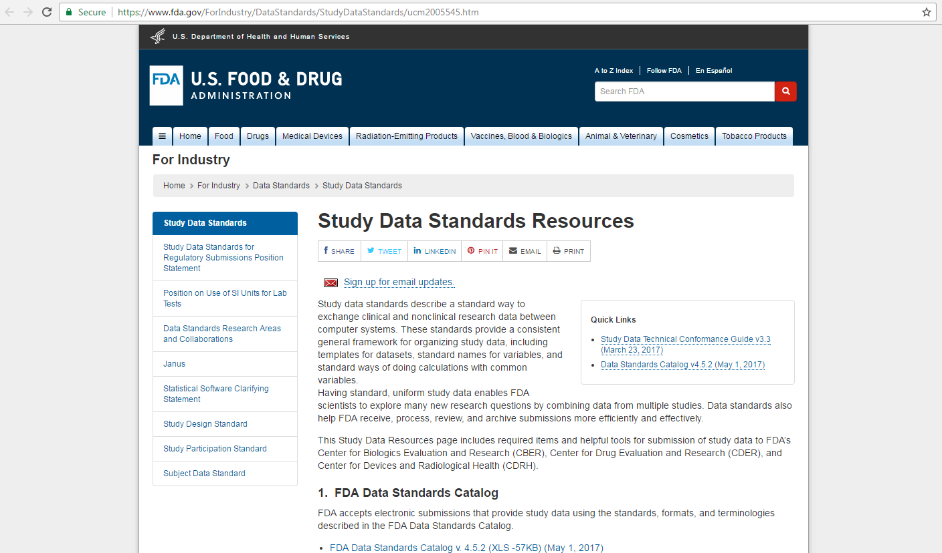
The FDA requirements
“Study Data Specifications” v.2.0 – 18 July 2012 associated to “Guidance for Industry: Providing Regulatory Submissions in Electronic Format”
https://www.fda.gov/ForIndustry/DataStandards/StudyDataStandards/ucm2005545.htm

Slide 5
The FDA requirements
Definition
“This is a blank CRF annotations that document the location of the data with the corresponding names of the datasets and the names of those variables included in the submitted datasets.”
Specifications
“the annotated CRF is a blank CRF…”
“maps each item on the CRF to the corresponding variables in the database”
“should provide the variable names and coding for each CRF item included in the data tabulation datasets”
“all of the pages and each item in the CRF should be included”
“the sponsor should write not entered in database in all items where this applies.”
“the annotated CRF should be provided as a PDF file. Name the file
blankcrf.pdf.”

Slide 6
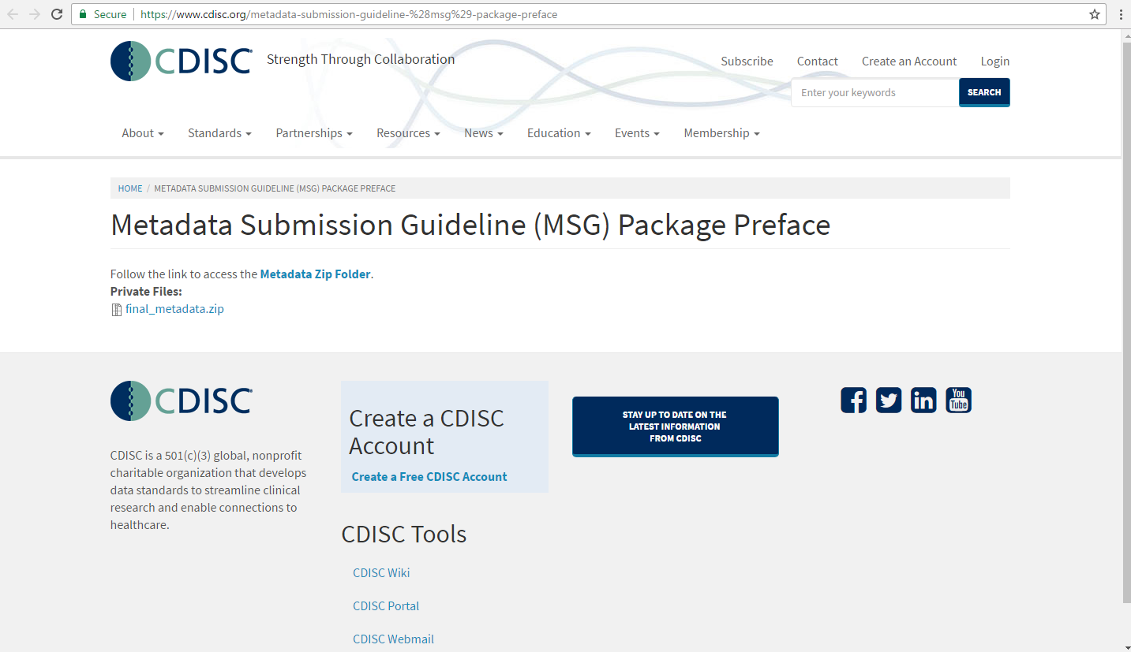
CDISC Metadata Submission Guidelines https://www.cdisc.org/metadata-submission-guideline-%28msg%29-package-preface
CDISC Guidelines – Overview

Slide 7
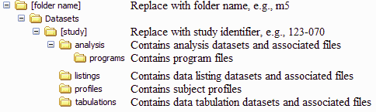
CDISC Guidelines – Overview
Annotations are meant to help the FDA reviewer find the origin of data variables included in the submitted datasets
Annotated CRF is to be provided to the FDA as a PDF file, named "blankcrf.pdf”
Sponsors can use their tool to create annotations
Tool currently used by FDA is Adobe Acrobat Professional
The “blankcrf.pdf” is stored in the tabulations folder along with the tabulation datasets

Slide 8
CDISC Guidelines – General rules
Annotations should reflect the data submitted within the SDTM.
Annotations of operational or derived data should not be included in the submission.
Annotations should be text-based and searchable using standard PDF viewers.
Annotations should not be handwritten on scanned pages.
Annotations in the “blankcrf.pdf” should appear as simple and as clean as possible.
Annotations should respect specific appearance and format (color, font) recommendations.

Slide 9
CDISC Guidelines – General rules
Each unique occurrence of submitted data should be annotated on the CRF.
Repetitive pages (e.g. Vital signs, Labs) should refer to the original page. A page number or similar reference and link to the associated annotated page should be included (e.g. “For Annotations see CRF page X”).
Data recorded but not submitted (e.g. Investigator’s signature or questions used for monitoring purposes “Any adverse events?”) should be annotated as “[NOT SUBMITTED]”.
For some points there is room for interpretation (“may be annotated”, 2-letter prefix and dot before variable name).

Slide 10
Specific rules: one-to-one relationship
ADVERSE EVENT FORM
Form A
page X/X
1. Event(s)
2. Pattern of the Event (tick one box only)
3 Seriousness
(several statements are possible from 1 to 6)
4. Onset date
(dd/mmm/yyyy)
5. End date
(dd/mmm/yyyy)
6. Intensity (tick one box only)
7. Action taken
(tick one box only)
8. Outcome
(tick one box only)
9. Relatedness Is there a reasonable possibility of relatedness?
(tick one box only)
AETERM
AEPATT
AESTDTC
AEENDTC
AESEV
AEACN
AEOUT
Intermittent
Continuous
Death
Life-threatening
Requires hospitalisation or prolonged hospitalisation
Disability or Incapacity
Congenital anomaly or Birth defect
Medically significant
None of the above i.e. Not serious
Mild
Moderate
Severe
Permanently discontinued
Stopped Temporarily
Dose reduced
Dose increased
No action taken
Unknown / Not applicable
Recovered/Resolved
Recovering/Resolving
Not recovered/Not resolved
Recovered with sequelae/Resolved with
sequelae
Fatal
Unknown
AEREL
1
2
1 2 3 4 5
6
7
1 2 3 1
2 3
4
5 6 1 2 3 4 5
6
Yes
No
AESDTH
1
2
1 2
3 4 5 6
7
1 2 3 1
2 3
4
5 6 1 2 3 4 5
6
Yes
No
AESLIFE
1
2
1 2 3
4 5 6
7
1 2 3 1
2 3
4
5 6 1 2 3 4 5
6
Yes
No
AESHOSP
1
2
1 2 3 4 5 6
7
1 2 3 1
2 3
4
5 6 1 2 3 4 5
6
Yes
No
AESDISAB
1
2
1 2 3 4 5
6 7
1 2 3 1
2 3
4
5 6 1 2 3 4 5
6
Yes
No
AESCONG
1
2
1 2 3 4 5 6
7
1 2 3 1
2 3
4
5 6 1 2 3 4 5
6
Yes
No
AESMIE
1
2
1 2 3 4 5 6
7
AESER
1 2 3 1
2 3
4
5 6 1 2 3 4 5
6
Yes
No

Slide 11
Specific rules: from horizontal to vertical structure
Vital Signs (VS) Domain:
Need to annotate fields pre-printed on the CRF (e.g.
Systolic Blood Pressure). They become values assumed by a more general variable (VSTESTCD).
Need for additional description to make the annotation: “VSTESTCD when VSTESTCD=“SYSBP””
Topic variable’s
value (e.g. SYSBP) is used to
current instance of the annotated
differentiate the
variable from the other tests.
Same applies to VSORRES and VSORRESU.

Slide 12
VS - Common “non-CDISC” annotation
VISIT 1
VISITNUM
Not done D₀ VSSTAT
VITAL SIGNS
WEIGHT Weight | | | | kg HEIGHT Height | | | | cm HR Heart Rate | | | | beats/min Blood Pressure | | | | / | | | | mmHg Systolic Diastolic
 | SYSBP |  | DIABP

Slide 13
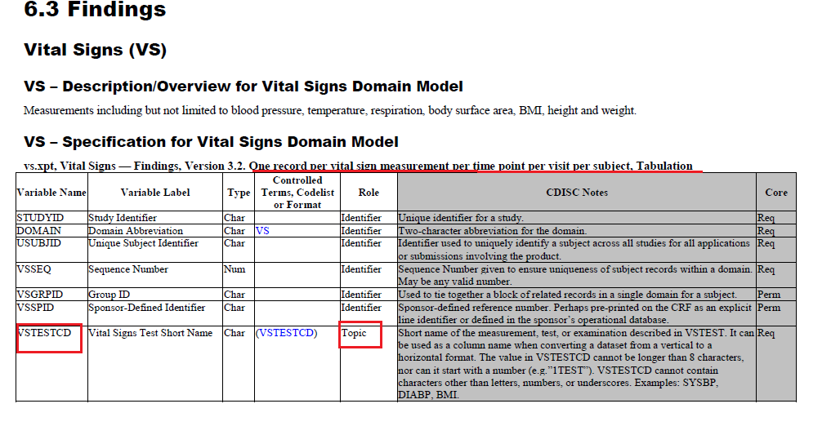
VS Domain SDTMIG 3.2.

Slide 14
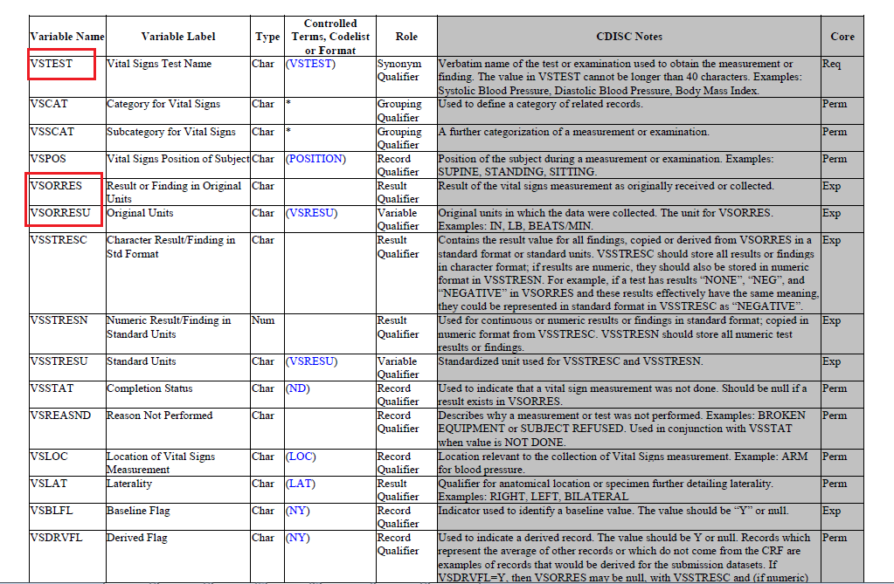
VS Domain SDTMIG 3.2.

Slide 15
From non-CDISC to CDISC
PATIENT
WEIGHT
(kg)
HEIGHT
(cm)
HR
(bmp)
DBP
(mmHg)
SBP
(mmHg)
001
85
180
70
80
120
USUBJID
VSTESTCD
VSTEST
VSORRES
VSORRESU
CH-001
WEIGHT
Weight
85
kg
CH-001
HEIGHT
Height
180
cm
CH-001
HR
Heart Rate
70
bpm
CH-001
DIABP
Diastolic Blood Pressure
80
mmHg
CH-001
SYSBP
Systolic Blood Pressure
120
mmHg

Slide 16
VS - CDISC annotation
VISIT 1 VISITNUM
Not done D₀
VSSTAT
VITAL SIGNS
VSTESTCD when
VSORRES when
VSTESTCD=“WEIGHT“
VSTESTCD=“WEIGHT”
VSORRESU when
Weight
|_ |___|___| kg
VSTESTCD=“WEIGHT”
VSTESTCD when
VSORRES when
VSTESTCD=“HEIGHT“
VSTESTCD=“HEIGHT”
VSORRESU when
Height
|_ |___|___| cm
VSTESTCD=“HEIGHT”
VSTESTCD when
VSORRES when
VSTESTCD=“HR“
VSTESTCD=“HR”
VSORRESU when
Heart Rate
|_ |___|___|
beats/min
VSTESTCD=“HR”
VSORRES when
VSORRES when
VSTESTCD=“SYSBP”
VSTESTCD=“DIABP”
Blood Pressure
|_ |_ |_ | / systolic
|_ |_ |___| diastolic
_{mmHg} VSORRESU when
VSTESTCD=“SYSBP” OR “DIABP”
VSTESTCD when
VSTESTCD when
VSTESTCD=“SYSBP”
VSTESTCD=“DIABP”

Slide 17
Annotating each variable data from different CRF pages
Disposition (DS) Domain:
provides an accounting for all subjects who entered the study.
may include protocol specified event), such as randomization, as well as
milestones (protocol-
informed consent and the subject's
completion status or reason for discontinuation.

Slide 18
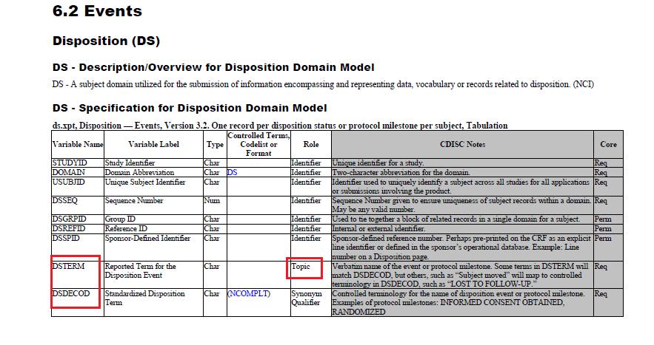
DS Domain SDTMIG 3.2

Slide 19
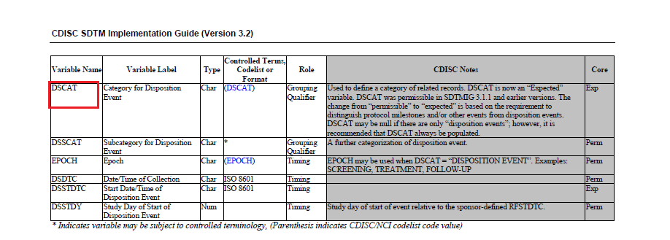
DS Domain SDTMIG 3.2

Slide 20
DS Domain - Example
USUBJID | DSTERM | DSDECOD | DSCAT | VISITNUM | DSDTC | DSSTDTC
CH-001 | INFORMED CONSENT OBTAINED | INFORMED CONSENT OBTAINED | PROTOCOL MILESTONE | 1 | 2009-01-12 | 2009-01-12
CH-001 | RANDOMIZED | RANDOMIZED | PROTOCOL MILESTONE | 2 | 2009-01-26 | 2009-01-26
CH-001 | SUBJECT MOVED | LOST TO FOLLOW-UP | DISPOSITION EVENT | 3 | 2009-03-06 | 2009-03-06

Slide 21
DS - CDISC annotation
VISIT VISITNUM
1
Visit Date: |_ |___| |_ |___|___| |___|_
D D M M M Y
Y
DSTERM when
DSTERM=”INFORMED
INFORMED CONSENT
CONSENT OBTAINED”
Participation agreement attestation:
I the undersigned, ………………………., certify that the patient’s written informed
[NOT SUBMITTED]
consent form has been read, understood, approved and signed by the patient after having
received information.
DSSTDTC when DSTERM=” INFORMED CONSENT OBTAINED”
Date of written informed consent signature |___|___| |___|_ |_ | |___|___|___|___|
D D M M M Y Y Y Y
Investigator’s Signature: ..…………………………………………..
[NOT SUBMITTED]

Slide 22
DS - CDISC annotation
VISIT 2 VISITNUM
DSTERM when
RANDOMISATION
Yes D No D
DSTERM= “RANDOMIZED”
Can the patient be randomised?
If “Yes”, please enter:
Randomisation Date:
| | | |_ | | _| |_ | | _|___|
D D M M M Y Y Y Y
DSSTDTC when
DSTERM=”RANDOMISED”
Randomisation no. | |_ | |
Please attach the label of the study medication here
If “No”, please fill in the Study Termination Form.

Slide 23
STUDY TERMINATION
Indicate the subject status at the time of completion/discontinuation. In case of discontinuation the Primary Reason should be ticked
DSTERM=”COMPLETED” when DSCAT= “DISPOSITION EVENT”
Completed
D0
DSTERM=”ADVERSE EVENT” when
DSCAT= “DISPOSITION EVENT”
D₁
Discontinued due to adverse event
Please fill in Adverse Event Form
DSTERM
Discontinued due to lack of efficacy
D2
DSDECOD=”LOST TO FOLLOW-UP”
D3 Please specify
when DSCAT= “DISPOSITION EVENT”
Discontinued due to lost to follow-up
…………… ^{DSTERM}...................
…………….
DSTERM
Discontinued due to recovery
D₄
DSTERM
Development of study specific
D₅
discontinuation criteria
Discontinued due to non compliance with
DSTERM study drug
D₆
DSTERM
Discontinued due to Death
D
7
Please fill in the both the Adverse Event
and Serious Adverse Event Forms
DSTERM
Discontinued due to withdrawal of
D₈
consent
DSDECOD
Other
D9
Please specify
…………………DSTERM ..............
………......
Date of completion/discontinuation | | | |___|_ | | | |___|___|_ |
 | DSSTDTC when DSCAT= “DISPOSITION EVENT” | D D M M M Y Y Y Y

Slide 24
Wildcard characters for domains
Some data collection fields relate to variables in more than one domain.
E.g. dates recorded in the page header at the beginning of the visit.
These fields should be annotated as:
“ - - DTC” where “ - - ” generically represents the 2-letter domain prefix (DS, DM, MH, etc.) and “DTC” is the shared variable designator.
The comment string should continued with a comma- delimited string of specific variables enclosed in square brackets “ - - DTC [DSDTC, DMDTC, MHDTC]”.

Slide 25
Chiesi Farmaceutici S.p.A
Clinical Study No. STUDYID
Centre No. | | | | | | | | | | | | | | | Screening No. | | | | | |
SITEID |  |  |  |  |  |  | SUBJID
VISIT 1 VISITNUM
Visit Date: | | | | |___| | | |
D D M M M Y Y
Y Y
- - DTC [DSDTC, DMDTC, MHDTC] when VISITNUM = ”1”
INFORMED CONSENT
Participation agreement attestation:
I the undersigned, ………………………., certify that the patient’s written informed consent form has been read, understood, approved and signed by the patient after having received information.
Date of written informed consent signature |___|___| |_ |___|___| |___|_ |___|___|
D D M M M Y Y Y Y
Investigator’s Signature: ..…………………………………………..
DEMOGRAPHY
Date of Birth
|_ |___| |___|_ |_ | |___|___|_ |_ | D D M M M Y Y Y Y
Sex
Male D
Female D

Slide 26
Supplemental Qualifier variables
SDTM does not allow the addition of new variables.
Non-standard variables and values are captured in the Supplemental Qualifier (SUPPQUAL) datasets together with the parent domain (domain the supplemental qualifiers relates back to).
Supplemental qualifier variables should be annotated using a 2-part name separated by a dot:
1st part: “SUPP - -” where “- -” denotes the 2-letter parent domain
2nd part: exact value of QNAM
e.g. SUPPDM.QVAL when QNAM=”RAND”

Slide 27
SUPPQUAL - Example
parent domain
short name of the qualifier variable
value assumed by QNAM
USUBJID
RDOMAIN
QNAM
QLABEL
QVAL
CH-001
DM
RAND
Randomized
Y
CH-001
DM
RANDNO
Randomization no.
23

Slide 28
SUPPQUAL - CDISC annotation
VISIT 2
RANDOMISATION
Can the patient be randomised?
 | Yes D No D | SUPPDM.QVAL when
 |  | QNAM=”RAND”
If “Yes”, please enter: Randomisation Date: | | | | | | | | | | | _| D D M M M Y Y Y Y Randomisation no. | |_ | | ^{SUPPDM.QVAL when} QNAM=”RANDNO” Please attach the label of the study medication here If “No”, please fill in the Study Termination Form.

Slide 29
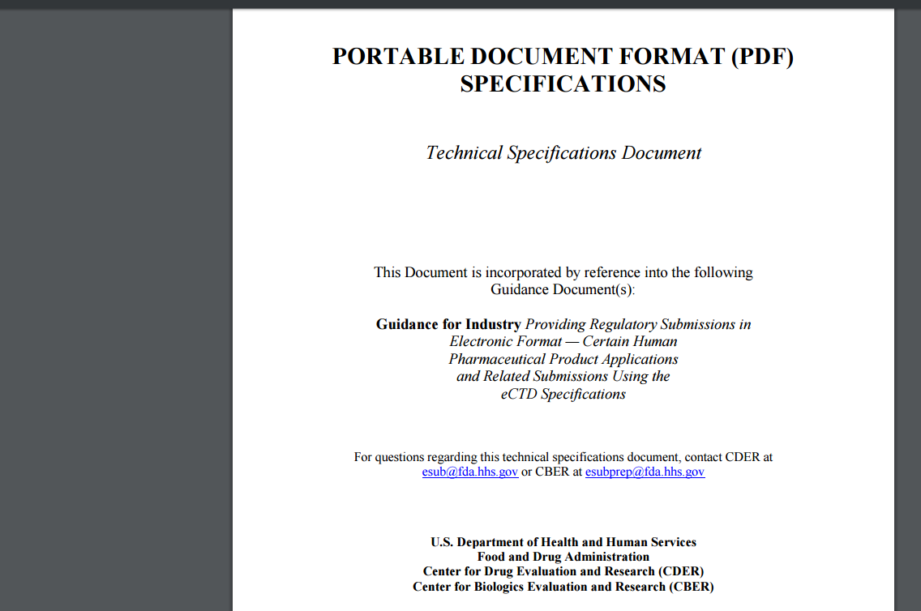
https://www.fda.gov/downloads/drugs/developmentapprovalprocess/formssubmissionrequirements/electronicsubmissions/ucm163565.pdf
The FDA requirements – appearance & format
“Portable Document Format Specifications” v 4.1 – 14 Sep 2016

Slide 30
The FDA requirements – appearance & format
Applicable to all .pdf documets (no CRF annotated specific) Very detailed requirements in terms of:
Font
Font size
Page orientation
Page size and margins
Source of electronic document
Bookmarks and hyperlinks
.
Aims: to facilitate reviewer (search, navigate) and to avoid problems which can affect the document appearance, structure and content

Slide 31
CDISC Guidelines – appearance & format
Reflects FDA general requirements for .pdf documents but is specific for annotated CRF:
All text which represent variable names CAPITALIZED.
Font color: color not used for text on the page.
•
•
•
•
Fill-in color: contrasting color for the comment.
Recommended annotation: “free text” annotation. Font: comments in Arial Bold Italic font.
Text size: equivalent in size to 12-point Times Roman, if possible.
Bookmarks: for each visit and each form.

Slide 32
Questions?
Thank you!

